Slide 1
CSET301 – AI-ML
Lecture 19 : Support Vector Machine (SVM)

Slide 2

Support Vector Machine (SVM)
“Support Vector Machine” (SVM) is a supervised machine learning algorithm which can be used for both classification or regression challenges.
However, it is mostly used in classification problems.
In this algorithm, we plot each data item as a point in n-dimensional space (where n is number of features) with the value of each feature being the value of a particular coordinate.
Then, we perform classification by finding the hyperplane that differentiate the two classes very well.
It can easily handle multiple continuous and categorical variables.

Slide 3
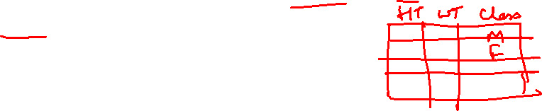
Support Vector Machine (SVM)
Lets say you have some data of height and weight for men and women. We want to classify this data.
women
men
weight
height

Slide 4
Support Vector Machine (SVM)
There can be multiple hyperplanes we can use to classify this data. Which of these planes is the optimal one?
women
men
weight
height

Slide 5

Support Vector Machine (SVM)
Lets say we chose this one as our hyperplane
Misclassified point
women
men
weight
height

Slide 6
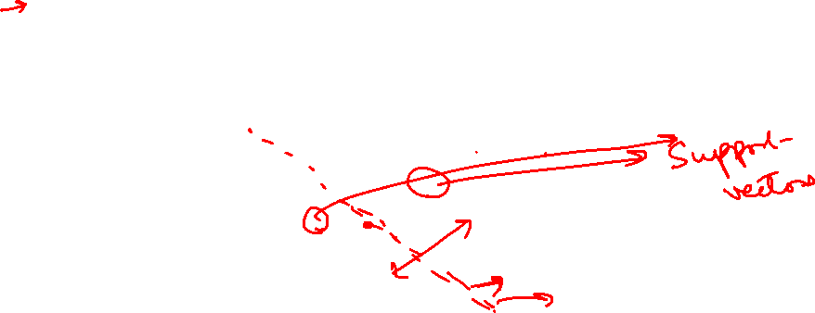
Goal of SVM
Select a hyperplane as far as possible from each class.
Goal: Find optimal separating hyperplane which maximizes the margin of the training data.
women
men
weight
Margin
height

Slide 7
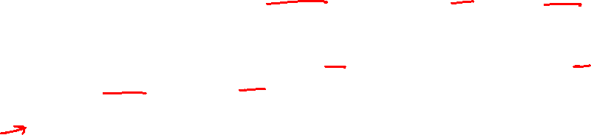
Margin and optimal hyperplane
Margin: A margin is a gap between the two lines on the closest class points.
– This is calculated as the perpendicular distance from the line to support vectors or closest points.
– If the margin is larger in between the classes, then it is considered a good margin, a smaller margin is a bad margin.
Hyperplane (Decision Boundary): A hyperplane is a decision plane which separates between a set of objects having different class memberships.
Margin Maximal Hyperplane : The best optimal line (hyperplane) with maximum margin
– There will never be any datapoint inside the margin.

Slide 8

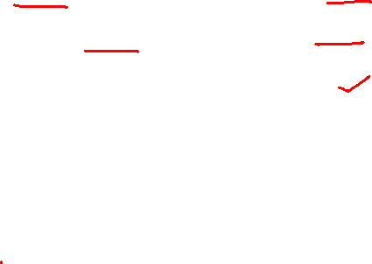

Support vectors
Support vectors are the data points, which are closest to the hyperplane.
These points will define the separating line better by calculating margins.
These points are more relevant to the construction of the classifier.
women
men
weight
Margin
Support vectors
height

Slide 9
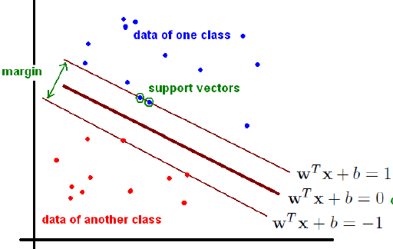
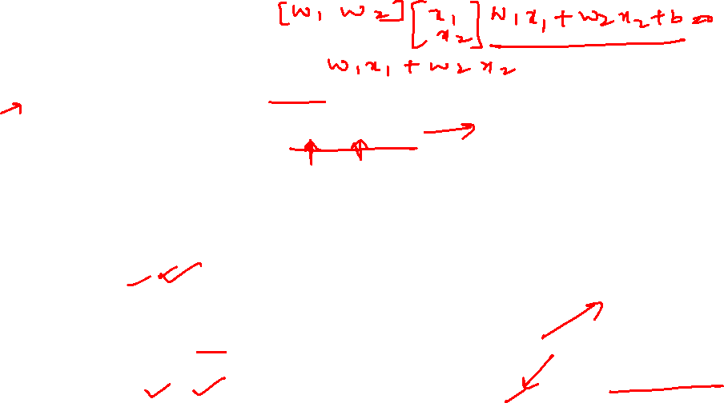
SVM Formulation
Goal: we want to find the hyperplane (decision boundary) linearly separating our classes. Our boundary will have equation:
w^{T} x + b = 0
Anything above the decision boundary should have label 1.
i.e., xi s.t. wT xi + b > 0 will have corresponding yi = 1.
Similarly, anything below the decision boundary should have label -1.
i.e., xi s.t. wT xi + b < 0 will have corresponding yi = -1.

Slide 10
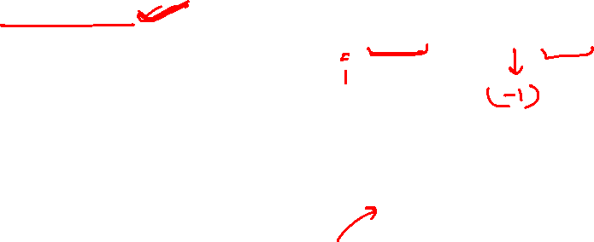
SVM Formulation
We can figure out if a data point has been classified properly by checking
that y(w^{T} x+b) >= 1
(which will be the case as long as either both y; w^{T} x+b > 0 or else y; w^{T} x + b < 0).

Slide 11
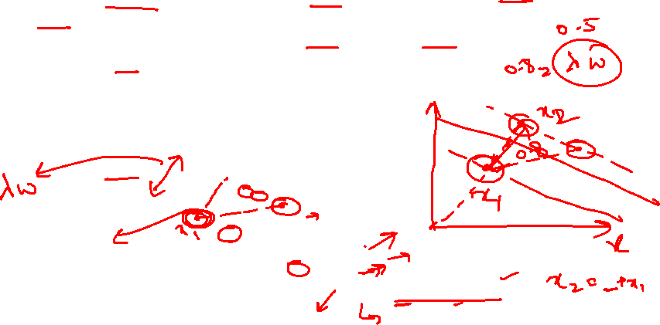
SVM Formulation
We have some space between our decision boundary and the nearest data points of either class.
Thus, let's rescale the data such that anything on or above the boundary
w^{T}x+b = 1 is of one class (with label 1),
and anything on or below the boundary w^{T}x + b = -1 is of the other class
(with label -1).

Slide 12
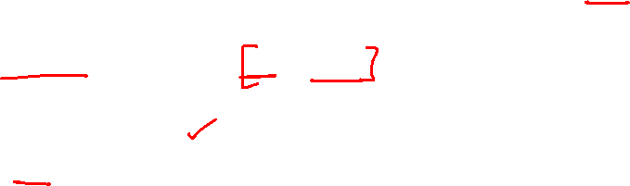
SVM Formulation
What is the distance between these newly added boundaries?
First note that the two lines are parallel, and thus share their parameters w; b.
Pick an arbitrary point x1 to lie on line w^{T}x + b = -1. Then, the closest point
on line w^{T}x + b = 1 to x1 is the point x2 = x1 + λw
(since the closest point will always lie on the perpendicular; recall that the vector w is perpendicular to both lines).
Therefore, λw will be the line segment connecting x1 and x2, and thus, λ||w||, the distance between x1 and x2, is the shortest distance between the two lines/boundaries.

Slide 13
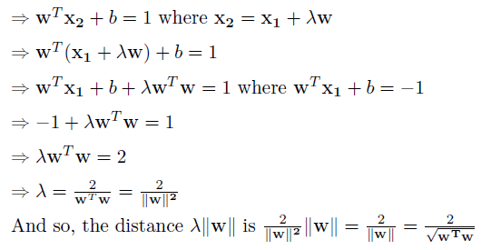
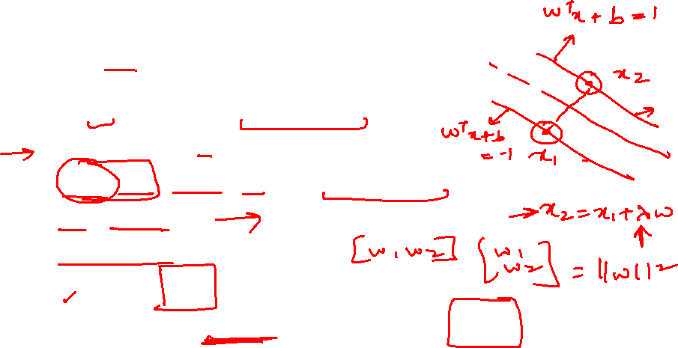
SVM Formulation
Solving for λ :

Slide 14


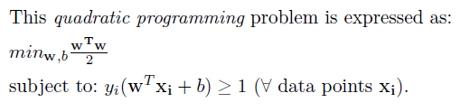
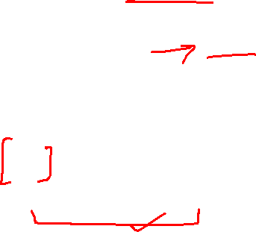
SVM Formulation
So we want to maximize
Which is equivalent to minimizing

Slide 15
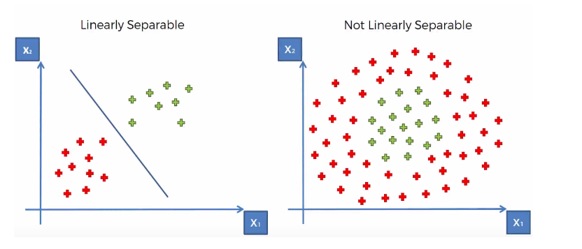
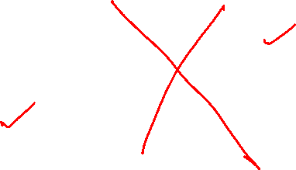
Non Linear SVM Classification
Non-Linear Classification

Slide 16
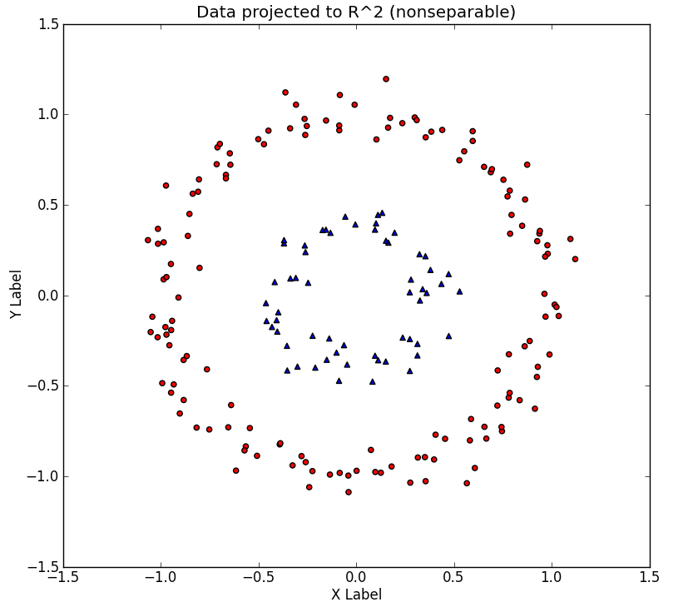
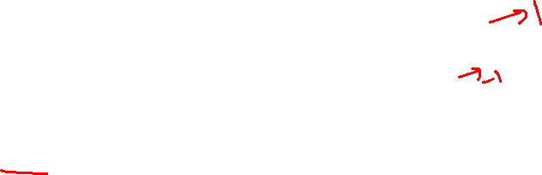
Non Linear SVM Classification
Consider the non-linear dataset, with its two concentric rings. Imagine that this dataset is merely a 2-D version of the 'true' dataset that lives in a 3-D space

Slide 17
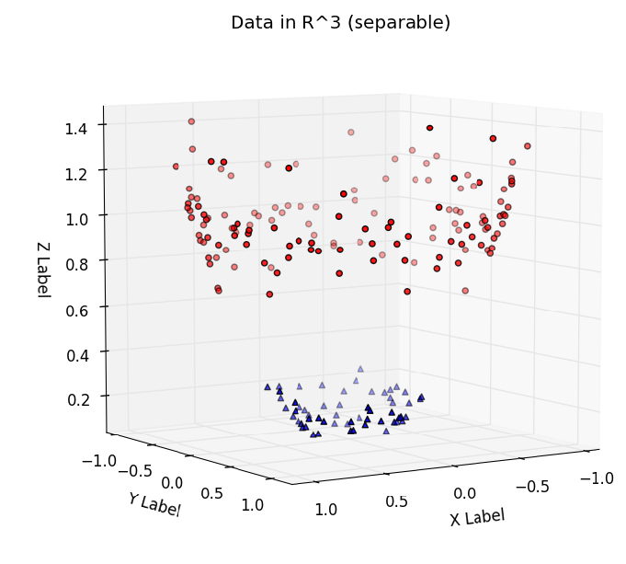
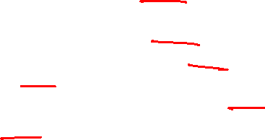
Non Linear SVM Classification
The dataset is easily linearly separable by a hyperplane. Thus, provided that we work in this space, we can train a linear SVM classifier that successfully finds a good decision boundary.
The challenge is to find a transformation 2D->3D, such that the transformed dataset is linearly separable.

Slide 18
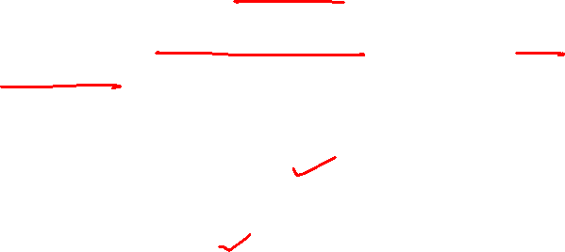
SVM Kernel
SVM uses a technique called the kernel trick.
Here, the kernel takes a low-dimensional input space and transforms it into a higher dimensional space.
In other words, you can say that it converts non-separable problem to separable problems by adding more dimension to it.
It is most useful in non-linear separation problem. Kernel trick helps you to build a more accurate classifier.

Slide 19
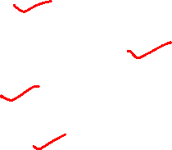
Kernel Types
• Linear Kernel
• Radial Basis Function Kernel
• Sigmoid Kernel
• Polynomial Kernel

Slide 20
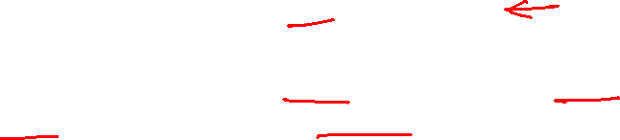
Radial Basis Function (RBF) Kernel
• Popular kernel function
• RBF can map an input space in infinite dimensional space.
K(x,xi) = exp(-gamma * sum((x – xi^2))
• Here gamma is a parameter, which ranges from 0 to 1. A higher value of gamma will perfectly fit the training dataset, which causes over-fitting. Gamma=0.1 is considered to be a good default value.
• The value of gamma needs to be manually specified in the learning algorithm.

Slide 21

Radial Basis Function (RBF) Kernel

Slide 22
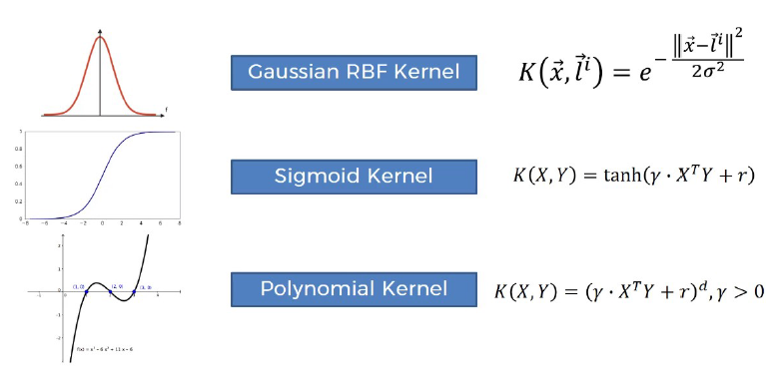
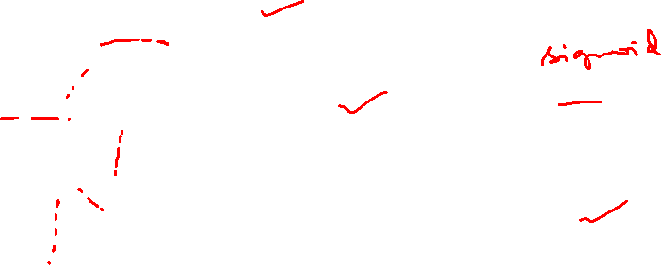
Kernel Types

Slide 23
Thank You

